Slide 1


Predicting a Movie’s IMDB Score
Alberto Ferrera

Slide 2
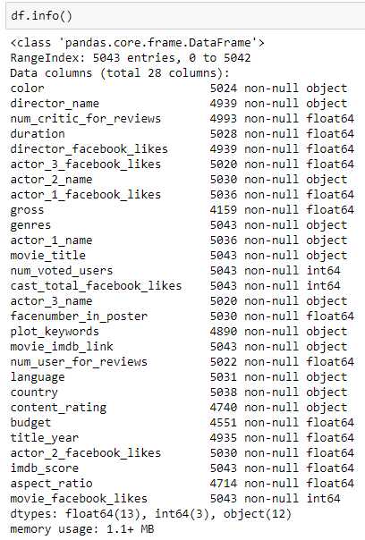
Goal
Predict future movie’s IMDB Score based on:
Color
Director’s Name
Number of Critics for Reviews
Duration
Number of Votes per Users
Investment
Profit
Facebook Likes
Etc.…

Slide 3
Midterm
The first part of the project consisted mostly on:
Business Understanding
Goal
Data Cleaning/Preparation
We got rid of missing and duplicate values.
Re-organized the data.
Business Intelligence
Answering simple business-related questions.
Correlation
Determining important/impactful variables.

Slide 4
Business Understanding
Goal: Use and interpret past IMDB data to understand movie performances.
Personally, I tried to understand relationships between human preferences and variables controlled by the producers.
Investment
Social Media Feedback
Current Market Trends
I predicted that Facebook likes and investments, for example, would have a positive relationship with the IMDB Score.
More Facebook likes/higher investment = higher IMDB Score

Slide 5

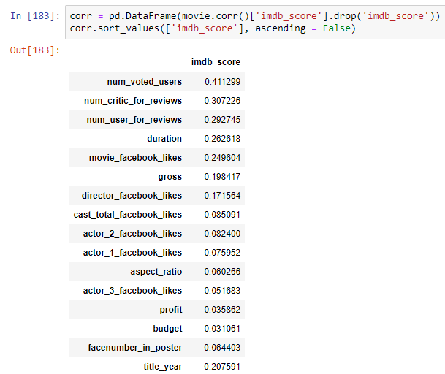
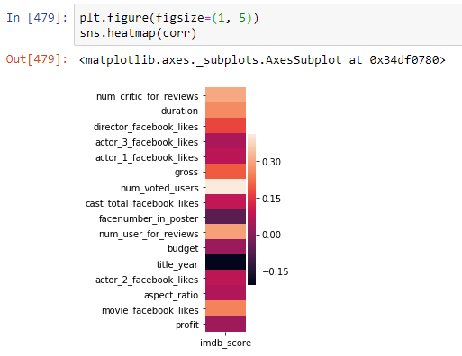
Correlation
In our final correlations, we confirmed that a few of the variables we predicted were as impactful as we thought. Still, other values were also as important.
Number of critics for reviews
Duration
Director Facebook likes
Gross

Slide 6
Final Project
Goal: Use our past findings to test the accuracy of our predictions and suggestions.
Data Preparation
Correlation
Regression
Classification
Clustering
Story Telling

Slide 7
Data Preparation
New data frame
IMDB Category
Dropping unnecessary variables
Dummies
Genres
Content Rating
Color

Slide 8
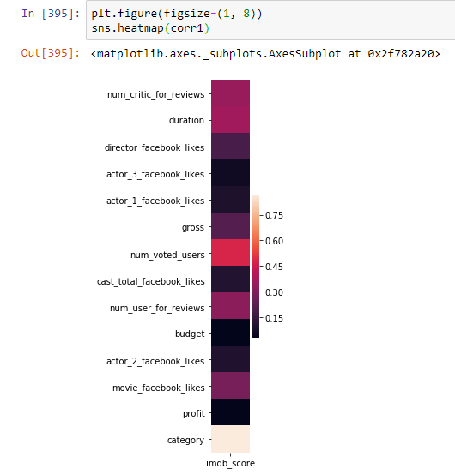
Correlation
In my opinion, these are the most important variables.
The lighter the shade of red = the higher the correlation of the variables with the IMDB Score.

Slide 9
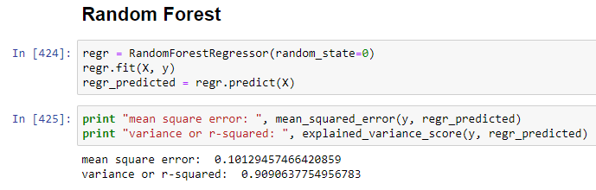
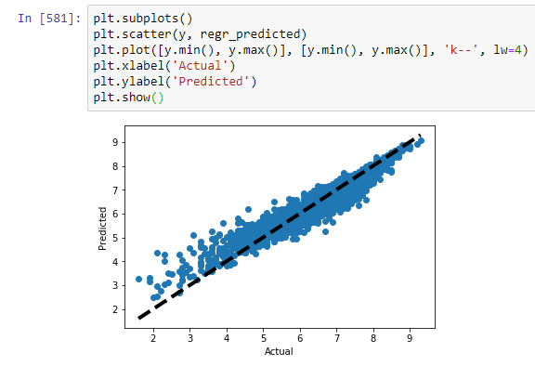
Regression
Best Model = Random Forest Regressor
MSE = 10%
R-Squared = 90.9%
Feature Selection (RFE) – top 3 ranked variables
Duration
Number of critics for reviews
Number of users for reviews
Multiple Regression
MSE = 75%
R-Squared = 32.5%
Ridge
MSE = 75%
R-Squared = 32.5%
Lasso
MSE = 75%
R-Squared = 32.5%

Slide 10
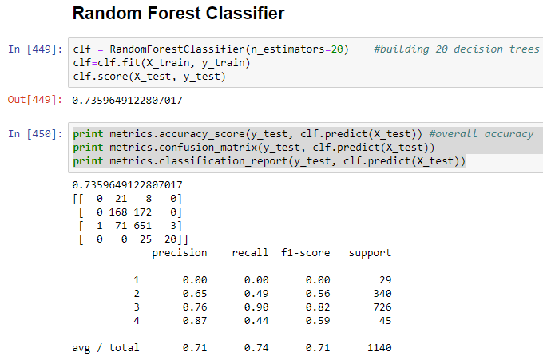
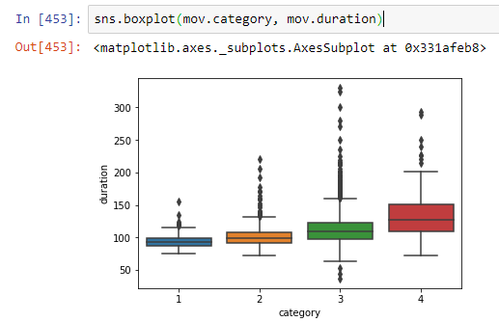
Classification
Best Model = Random Forest Classifier
Accuracy 74%
Feature Selection (RFE) – top 3 ranked variables
Duration
Number of critic for reviews
Number of user for reviews
RFE:
Accuracy = 65%
Decision Tree
Accuracy = 68.3%
Decision Tree (reduced depth)
Accuracy = 71.8%
KNN
Accuracy = 52.1%

Slide 11
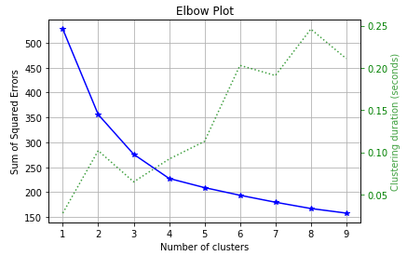
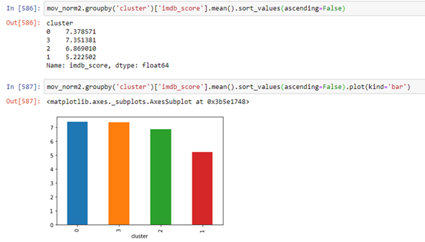
Clustering
Profiling:
Our cluster 0 and cluster 3, have very close IMDB Scores and some categories favor one or the other.
For example, we can observe that movies with:
Avg Duration of 126 min get the highest IMDB Score = cluster 0.
Higher average number of critic for reviews and number of voted users: 363 & 315503 respectively, fall under cluster 3.
This may mean that, since cluster 0 has a higher avg IMDB Score, that movies that fall within 126 min, and receive averages of 256 number of critic for reviews and 294000 number of voted users, get higher IMDB Scores.
Data Normalization
Elbow Method
4-6 clusters
Cluster Deployment
Random Forest Classifier
Unfortunately:
Accuracy = 15%

Slide 12
Story Telling
According to everything we’ve gone through:
Most important variables:
Duration
Number of critic for reviews
Number of voted users
Unfortunately
Most of this information is gathered after the movie has been released.
Scale does not consider producer-controlled variables as highly influential.
With the exception of a few like Duration and investment.
Suggestions: Choosing high-quality and consumer-recognized directors and actors. A considerable investment can help for future favorable reviews and likes. The movie should fall within the 123-126 min range. Think about the audience, at the end, they are the actual judges for a successful movie, and IMDB has realized that by creating their scale/ranking.

